Slide 2
SLTT Tiger Team
State, Local, Tribal and Territorial (SLTT) Information Exchange

Slide 3
introduction
State, Local, Tribal and Territorial (SLTT) Tiger Team Co-Chairs
Mike Phillips Vice President SLG Innovation michaelphillips@siginnovation.com | Paul Wormeli Innovation Strategist Wormeli Consulting, LLC pwormeli@wormeliconsulting.com

Slide 4
Mission: Facilitate interagency and cross-domain information exchanges to improve the safety and quality of life for our citizens
Sltt TIGER TEAM

Slide 5
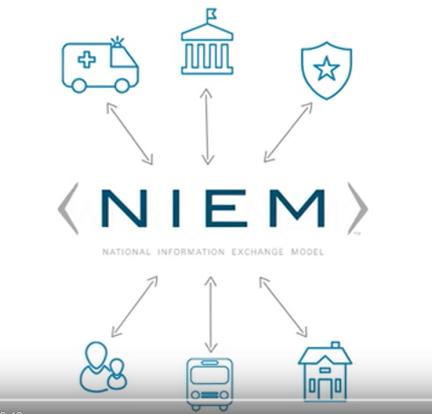
NIEM Simplified
Click play to begin
https://www.youtube.com/watch?v=BA1jY8LJ8tM
Notes:
Let’s watch a short clip that provides a simplified explanation of NIEM.

Slide 6
Information exchanges built on NIEM
Examples
Interstate Justice and Public Safety Network (NLETS) Exchange mission-critical law enforcement information
America’s Missing: Broadcast Emergency Response Alert (AMBER) Child abduction emergency alert
Prescription Drug Monitoring Exchange (PMIX) Mitigate pharmaceutical drug abuse across state lines
FBI Incident Reporting National Data Exchange System (N-Dex) Standardized, secure criminal justice information sharing to relevant criminal justice agencies
FBI National Crime Information Center (NCIC) U.S.’s central database for tracking crime-related information
Centers for Disease Control and Prevention (CDC) Emergency Preparedness and Response Exchange Requirements Exchange and sharing of critical emergency management data
National Electronic Interstate Compact Enterprise (NEICE) Placement of children in foster care across state lines
Indian Child Welfare Act (ICWA) e-Notice

Slide 7
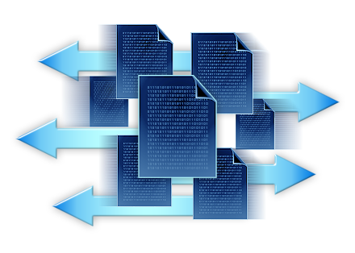
Exchange data in motion
Scope-of-NIEM
COMMONLY FORMATTED DATA
LEGACY
DATABASES
INTERFACE
INTERFACE
LEGACY
DATABASES
Translation
NIEM intentionally does not address standardizing data inside legacy systems.
NIEM serves as a translation layer (providing a common understanding) between and across disparate systems.

Slide 8
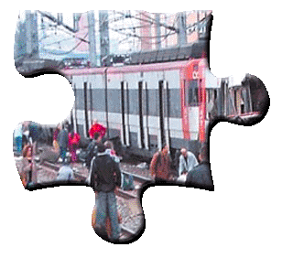
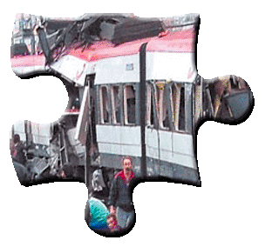
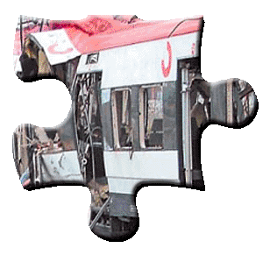
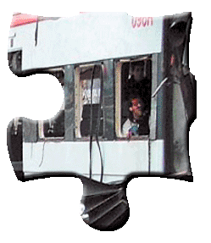
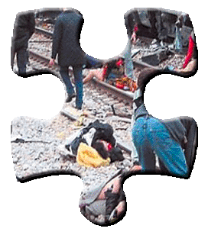
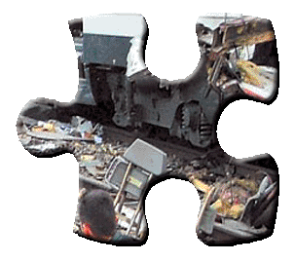
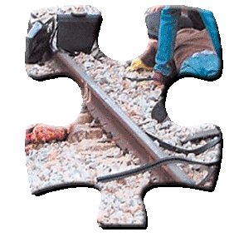
The basis of collaboration
Lives are at stake!

Slide 9
An AXIOM:
Information sharing
is at the heart
of how we can
improve outcomes of service

Slide 10
Roadblocks to interoperability
Silos of incompatible and proprietary software
Lack of consensus on data standards
Cultural impediments to information sharing
Resources for making improvements

Slide 11
NIEM contribution
Semantic Interoperability
Agreement on consistent terminology and meanings
Syntactic Interoperability
Standards for how data is represented

Slide 12
NIEM FRAMEWORK
COMMUNITY | TECHNOLOGY | RESOURCES
Formal governance Trained developers Mission-oriented domains Domain stewards | Data model Data standards Development methodology Predefined templates | Development tools Training programs Technical support Knowledge Center

Slide 13
Niem stakeholders
Local
State
Federal
COLLABORATION
Tribal
Territorial
CONSENSUS
International
Private
Sector
EQUALITY

Slide 14
NIEM’s Governing STRUCTURE
ESC
Executive Steering Council
The ESC is NIEM’s decision-making body regarding membership, funding requirements, program or technical direction, personnel appointments, and other organizational decisions
NMO
NIEM Management Office
The NIEM Executive Director and Management Office resources executes ESC’s vision of NIEM while managing NIEM’s day-to-day operations
NTAC
NBAC
NIEM Technical Architecture Committee
NTAC defines the technical architecture associated with NIEM development and implementation, implements, and maintains the technical specifications for the NIEM community
NIEM Business Architecture Committee
NBAC includes membership from all NIEM domains Primary responsibilities include harmonization and issue resolution across NIEM core and individual domains
Technical Architecture and Specifications |  | Semantic Content for Reference Models
Communities sharing a common need to exchange information

Slide 15
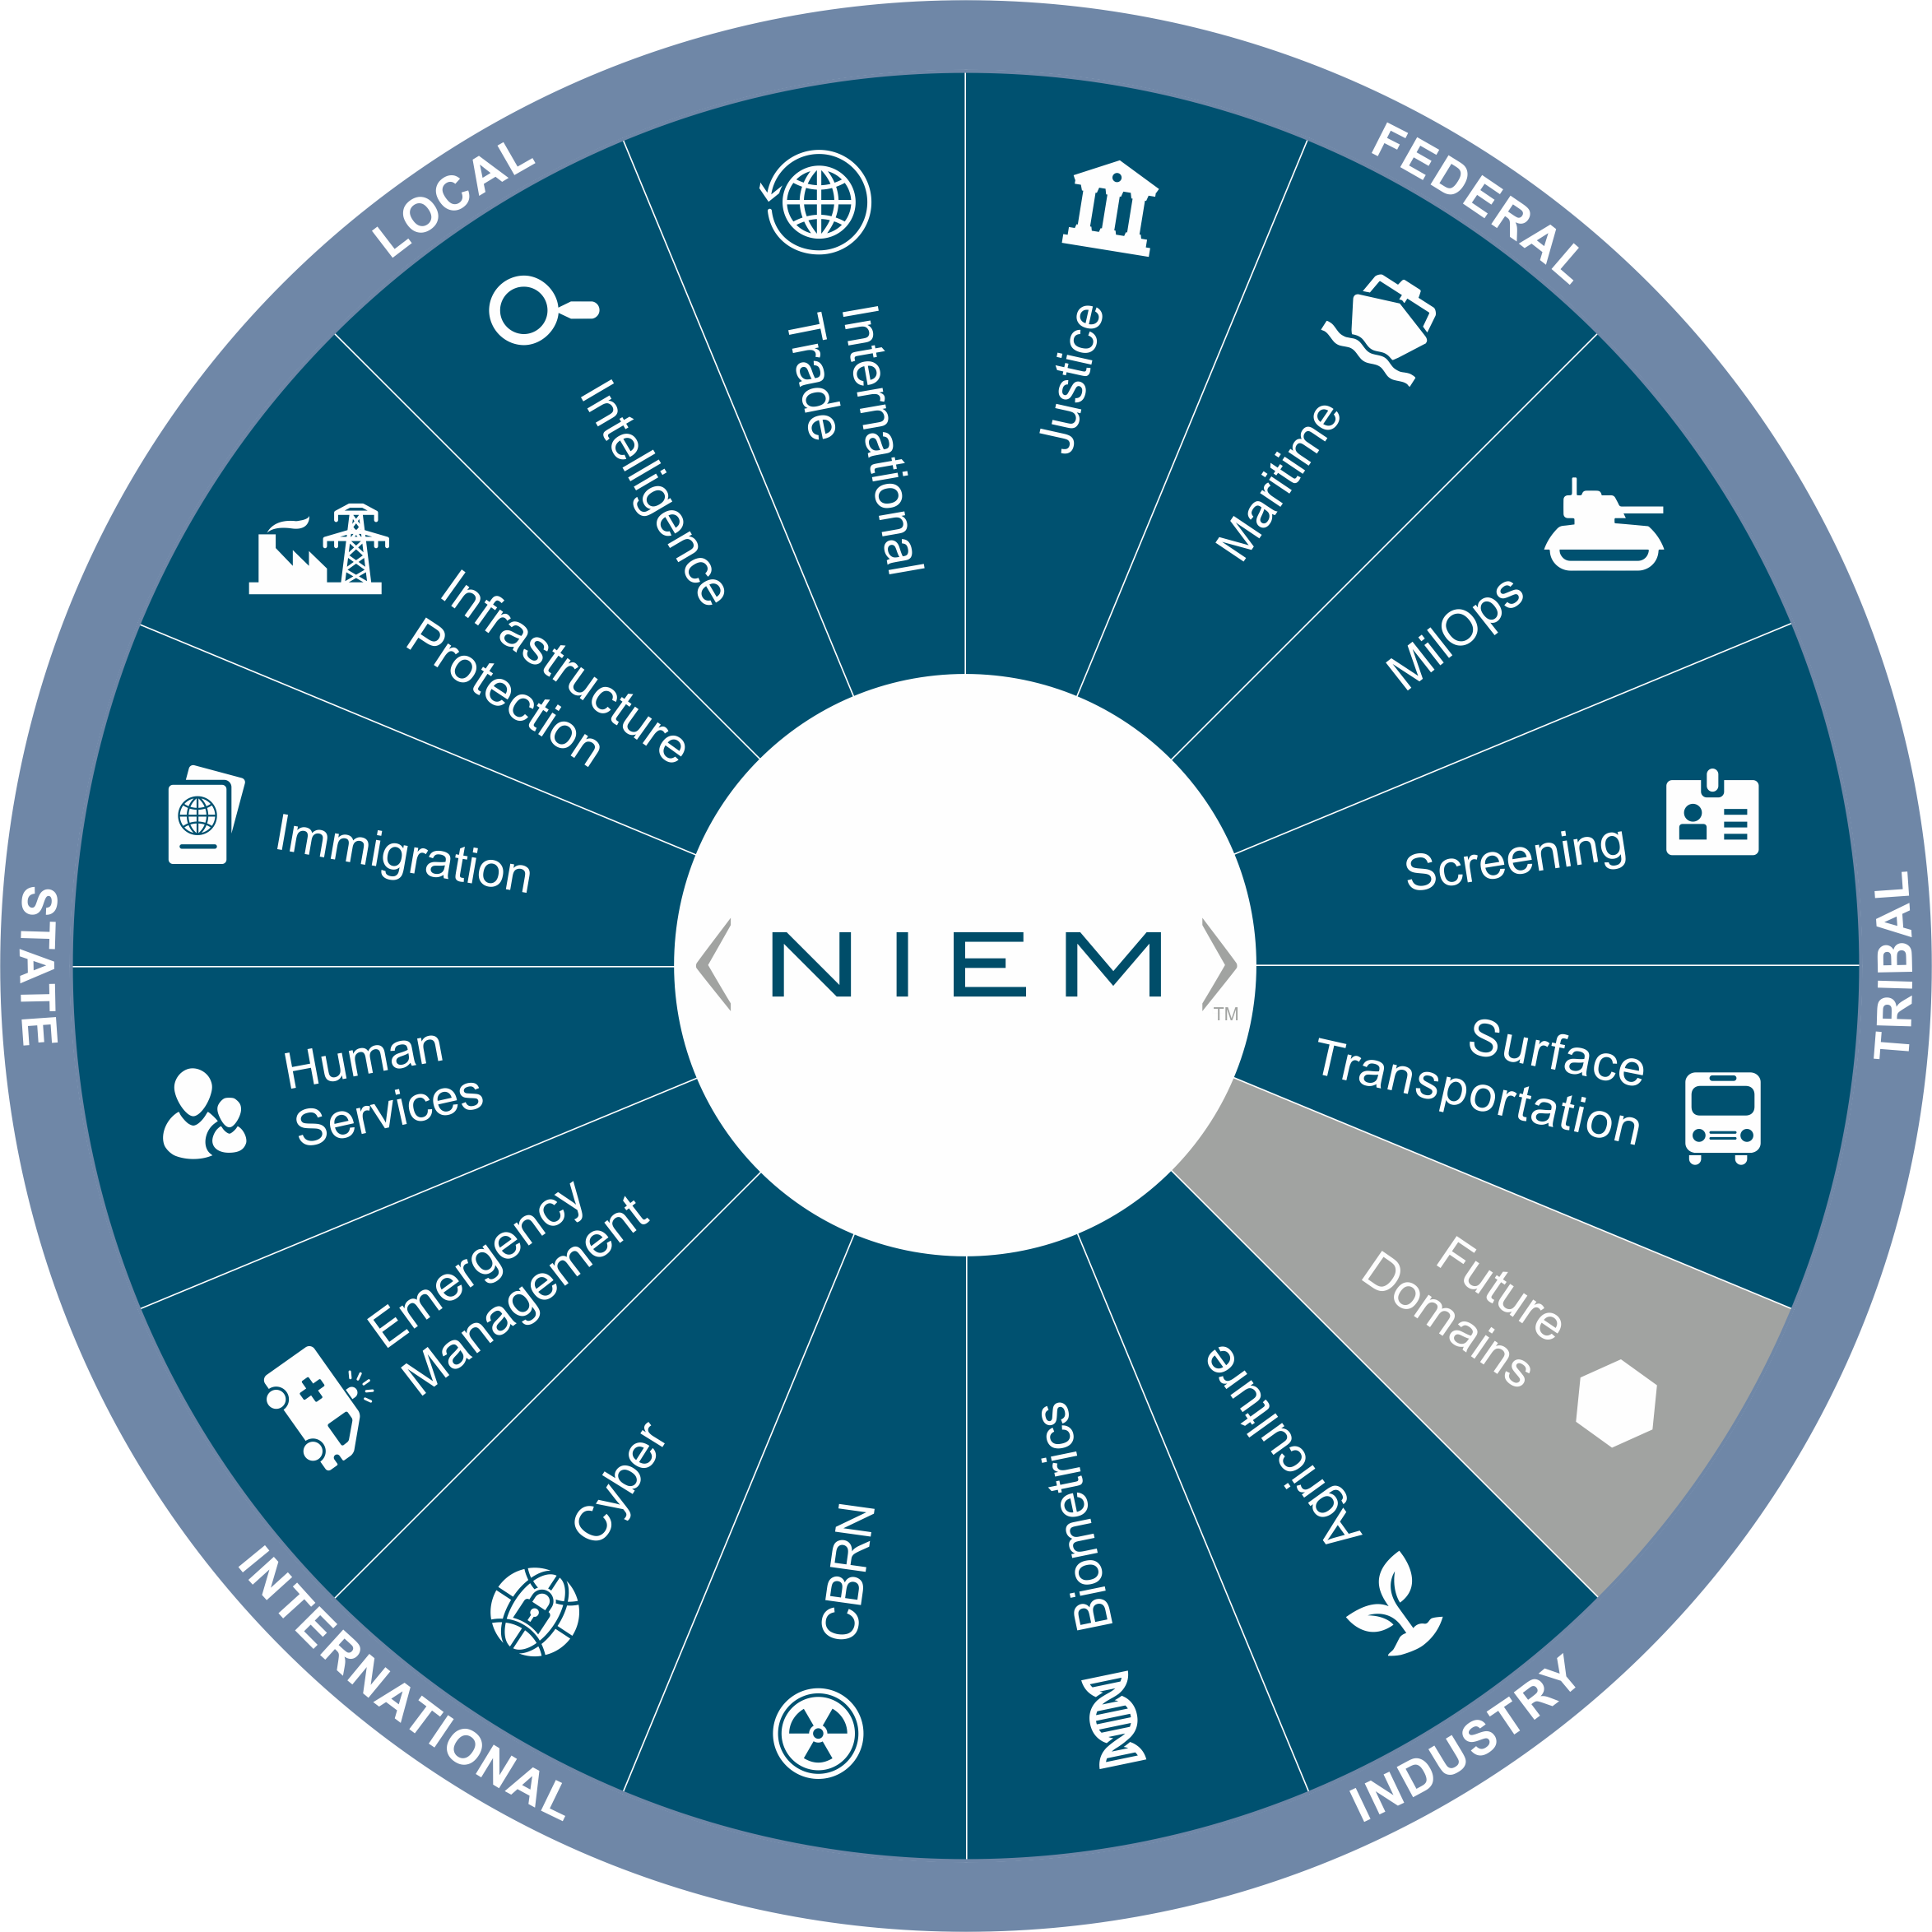
NIEM DOMAINS
Agriculture
Biometrics
CBRN
Cyber
Emergency Management
Human Services
Immigration
Intelligence
International Trade
Justice
Maritime
Military Operations
Screening
Surface Transportation
Planned Domains & Communities of Interest
Statistics
Health
METOC
Logistics
Humanitarian Aid

Slide 16
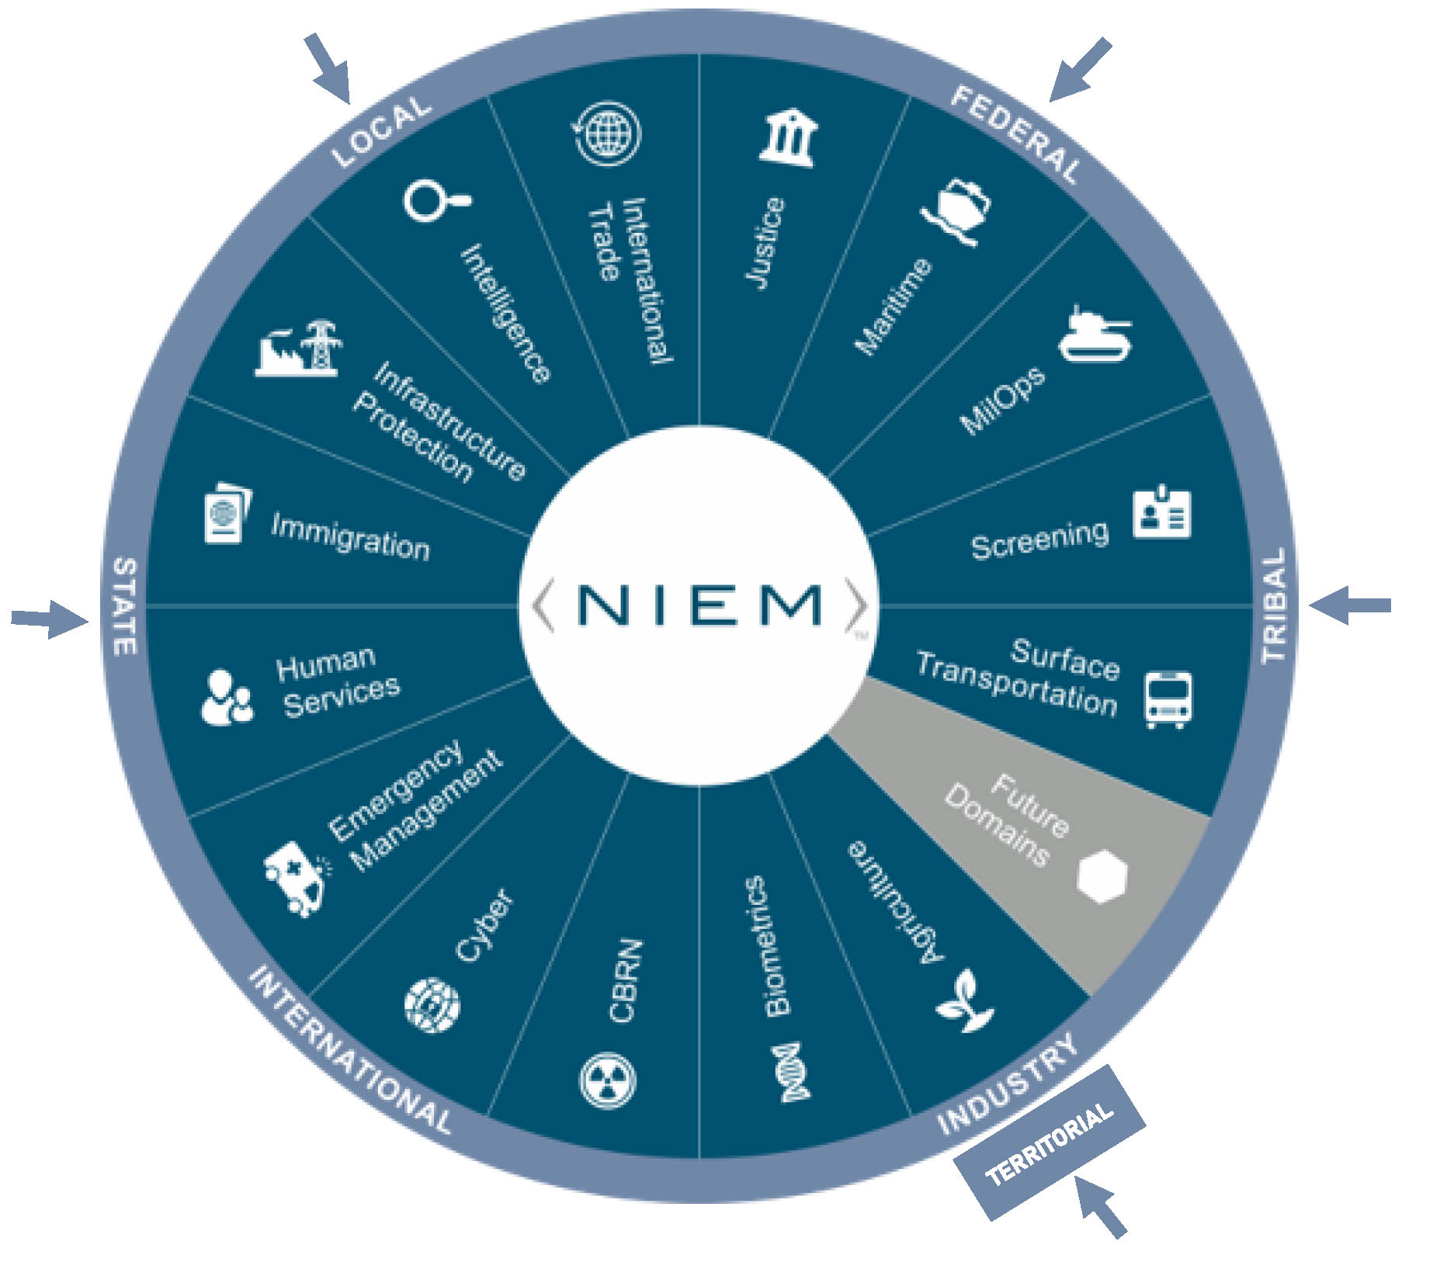
Solution is Domain homogenization
For scenarios

Slide 17
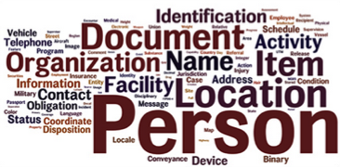
niem technology the data model
NIEM Core
Data elements commonly agreed upon across all domains
NIEM Domains
Mission-specific data elements unique to a domain expanding beyond the core
Naming and Design Rules

Slide 18
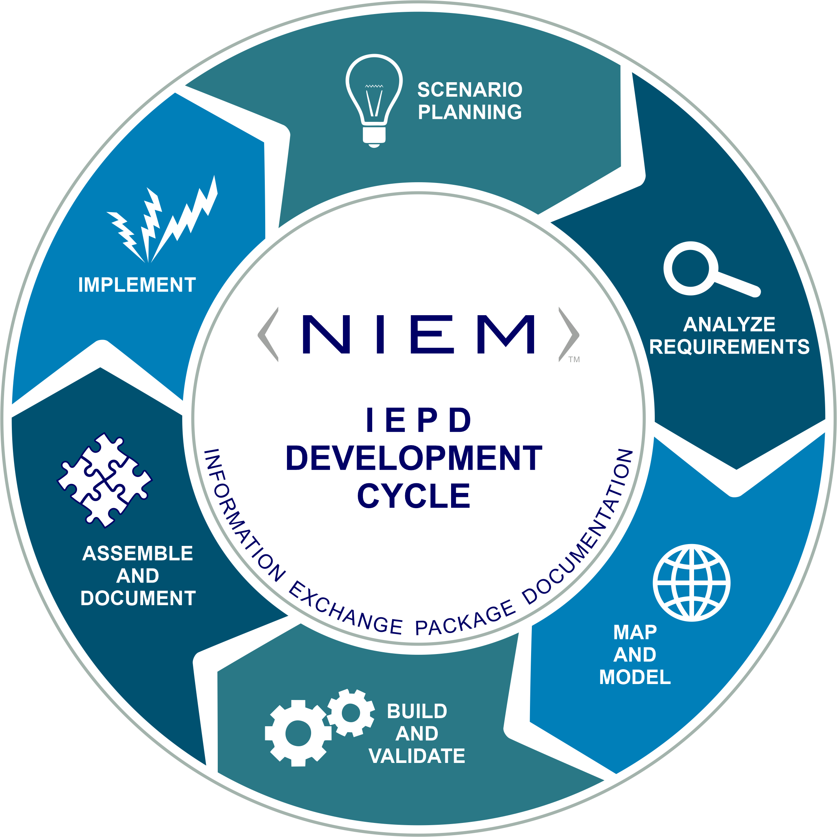
niem technology methodology
Information Exchange Package Documentation
(IEPD)
A structured template for specifying the content of exchanges

Slide 19
Audience-Specific IEPDs Here
IEPD Name
IEPD Description

Slide 20
NIEM resources
Tool Catalog
Information exchange (IEPD) development
Model management​
Model search and discovery
Information exchange storage, search, and discovery
On-line training classes
Migration and other technical assistance

Slide 21
Standards based on niem
Examples
ANSI 42.42 Radiological Nuclear detectors – CBRN Domain
ANSI APCO Alarm Monitoring Company to Public Safety Answering Point (PSAP)
OASIS EXDL, Emergency Data Exchange Language FEMA (Emergency Management Domain)
NIST Big Data Framework Vol 7
National Fire Protection NFPA 950 calls for compliance with NIEM Emergency Incident Data Document (EIDD) IEPD – NISTIR 8255
Biometrics ANSI/NIST ITL Standard – Biometrics Domain
Biometric Conformance Test Software (BioCTS)
Model Minimum Uniform Crash Criteria Guideline (MMUCC) – Department of Transportation

Slide 22
Why NIEM?
Collaboration
NIEM brings stakeholders together through reuse and community engagement
Consistency
NIEM provides consistency through reusable schema, which allows for many implementation options
Development
Flexible and extendable, NIEM saves development time through agreed-upon elements, relationships, and formats independent of how information is stored in individual systems
Support
New users can leverage what already exists and engage directly with other NIEM members for assistance
which leads to
Lower Development Costs | Enhanced Mission Capabilities | Common Vocabulary | Reduced Maintenance Costs
Faster Mediation | Rapid Implementation | Increased Interoperability | Reuse

Slide 23
Niem SUCCESS STORY

Slide 24
NIEM SUCCESS STORY
NIEM Impact - Pharmaceutical Drug Monitoring
Standard Prescription Monitoring
Information Exchange (PMIX)

Slide 25
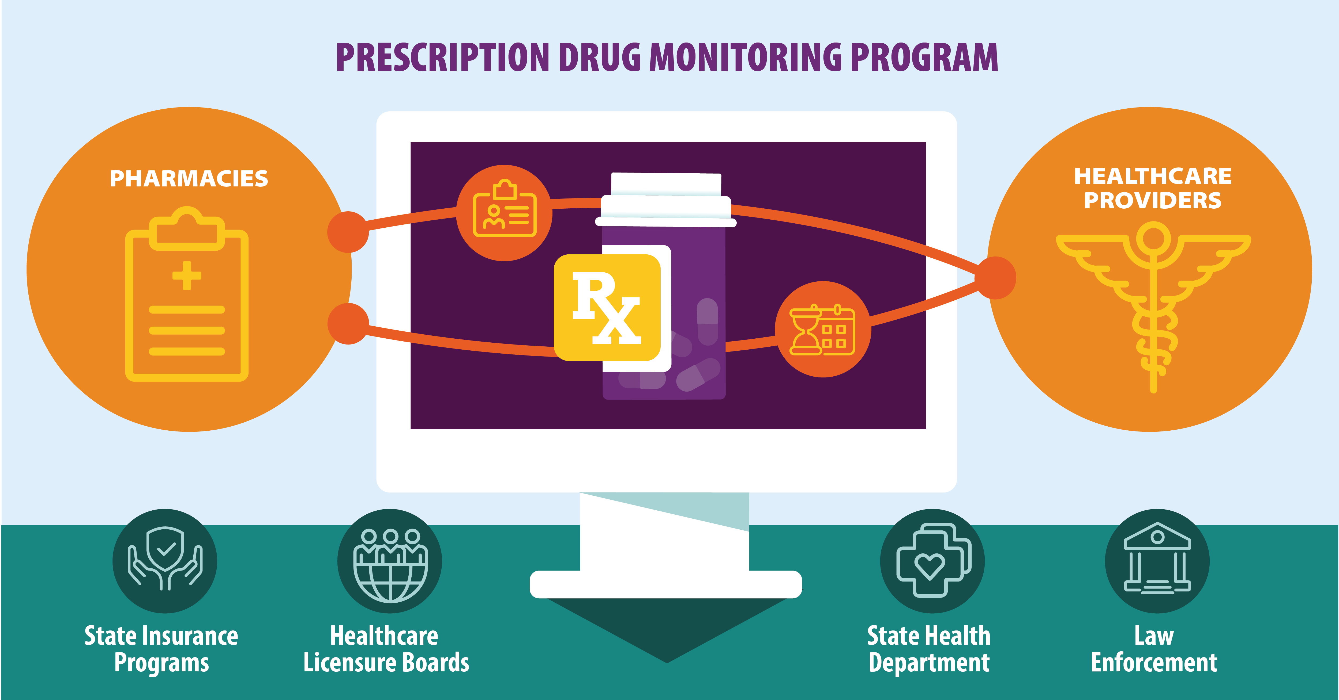
Opioid crisis
As diversion of controlled substances and their abuse escalates,
how can we improve interstate monitoring of drug use?
How do we enable prescription drug monitors
to see across state lines?

Slide 26
Prior to NIEM, there was large gap in interstate reporting
As abuse and diversion escalated, law enforcement and health practitioners needed a standardized, scalable solution to share drug purchases and distribution
The Standard NIEM Prescription Monitoring Program Information Exchange assists prescribers, health agencies, and law enforcement in identifying potential abuse and diversion

Slide 27
<Focused Close tailored to the specific audience>
Summary of specific benefits and opportunities
You can participate in the NIEM State, Local, Tribal, and Territorial (SLTT) Tiger Team
Potential grant funding for your NIEM initiatives
We are here to help you be successful

Slide 28
Questions?
State, Local, Tribal and Territorial (SLTT) Tiger Team Co-Chairs
Mike Phillips Vice President SLG Innovation michaelphillips@siginnovation.com | Paul Wormeli Innovation Strategist Wormeli Consulting, LLC pwormeli@wormeliconsulting.com

Slide 30
Back up additional sltt related slides

Slide 31
Response to Terrorism
Currently, there are scattered pieces to the solution
Intelligence
Emergency Management
Transportation
Human Services
Cyber
Infrastructure
Justice
Screening
Jurisdictions must bring about results with the sense of urgency this issue truly merits
Notes:
Records Management Data:
Suspects
Accident Reports
Incident Reports
Field Interviews
Etc.

Slide 32
Strategies
Define Market Priorities
Analyze NIEM contributions
Establish clear business case
Communicate with market segments
Build and energize resources for implementation
Establish a sense of controlled urgency

Slide 33
tactics
Cross-domain solution focus
Work with the National Association of State Chief Information Officers (NASCIO) to increase state-level participation in relevant domains
Work with the National Association of Counties (NACO) and PTI to energize county and city participation
Work with the Integrated Justice Information Systems (IJIS) to engage industry support and encourage NIEM representation
Create an active community exchange
Promote special conditions on grants related to information sharing
Increase communications to SLTT influencers

Slide 34
2021 State CIO Top 10 Priorities*
Cybersecurity and risk management
Digital government/digital services
Cloud services
Broadband/wireless connectivity
Budget, cost control, fiscal management
Data management and analytics
Consolidation/optimization
Identity and access management
Workforce
Customer relationship management
IDENTIFY PRIORITY SCENARIOS
Vaccinations Registry
Virus Test Results
Cyber Incident Reporting
FEMA Claim Submission
*Source: NASCIO survey, State CIO Top Ten Policy and Technology Priorities for 2021. December 9, 2020.

Slide 35
Niem RESOURCES
Executive briefing materials
Articles for association publications
Update selected videos
NIEM tools and applications
SLTT Speakers Bureau
Webinars targeted at SLTT audiences
Grant special condition language
Case Studies

Slide 36
Collaborators
SLTT
Tiger Team
STAKEHOLDERS
NBAC
REAL RESULTS
NIEM
ESC, NMO
& NTAC
NIEM
Domain
Stewards
Associations

Slide 37
SLTT Milestones
90 days
Executive briefing package completed
Association engagement
180 days
Target scenarios finalized
Briefings to SLTT executives in target domains
270-360 days
NIEM projects initiated
Expanded training offered
Action Team Identified
Scenarios Prioritized
Articles published in association media
Success Stories / Case Studies

Slide 38
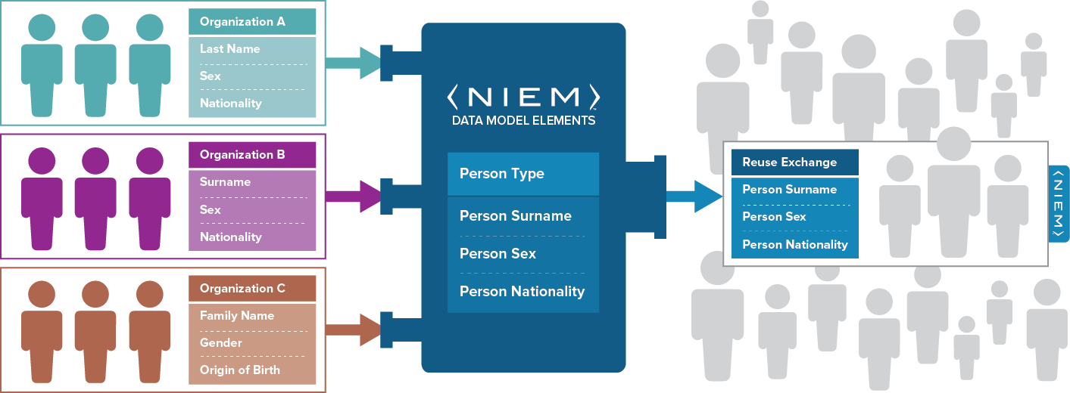
Niem in action Data Components and Data Elements exchanges
NIEM IS
a common vocabulary that enables efficient information exchange across diverse public and private organizations.
NIEM IS NOT a system or database; it does not specify how to transmit or store data.
Using NIEM, organizations come together to agree on a common vocabulary.
When additional organizations need to be added to the information exchange,
the initial NIEM exchange can be reused, saving time and money.
Notes:
Now, let’s look at NIEM in action.
It’s important to note that NIEM is NOT a system, database, software, or the actual information exchange itself. Rather, NIEM provides the common vocabulary so that organizations can speak the same language to quickly and effectively exchange meaningful data.
NIEM is the standard way of defining the contents of messages being exchanged.
Interoperability is a characteristic of information systems that use NIEM to exchange information—NIEM allows for the quick and easy addition of exchange partners, regardless of technologies being used.
For example, two organizations identify the need to exchange information. Their information, though similar, is defined differently. Both organizations have a concept of a person’s last name. One refers to it as “last name” while the other refers to it as “surname”—the same concept, but different defining term.
Using NIEM, the organizations are able to come together to agree on a common vocabulary.
When additional organizations need to be added to the information exchange, the initial NIEM exchange can be reused, saving time and money.

Slide 39
NIEM is …
Communities
Data Model
Reusable Process
Federal, State, Local, Tribal, Territorial, International, Private Sector
Self-Managing Domain Stewards
Voluntary Consensus Standards
Help Desk & Knowledge Center
Established Training Program
Organized as a core with subject-area domains, expressed as reusable XML Schema components
A template for designing information exchange specifications by reusing XML Schema components
Technical Specifications

Slide 40
Data Interoperability problem
DATA
UNDERSTANDING
IF THESE AREN’T COMPATIBLE…
DATA
UNDERSTANDING
THIS WON’T WORK
DATA
EXCHANGE @ RUNTIME
SYSTEM / APPLICATION
SYSTEM / APPLICATION
Notes:
What is slide trying to say….Well, if I say ‘vessel’ and you say ‘boat’, and he says ‘ ship’, and she says ‘conveyance’, we may mean the same thing, but we have no way to tell our computer systems to behave and treat the words as having the same meaning. Until we do, we’ll all have different facts about the same world-pieces of the big puzzle—but no common understanding.
if the people on the left have a different understanding than the people on the right…….. then something will be broken and someone will be unhappy. This picture simplifies the data interoperability challenge ……. most information sharing and data exchanges involve more than two systems/organizations. Sometimes its connecting multiple systems within a component, or component to component, or component to external federal, state, local, tribal, territorial, private sector, international partners.
What we need is a way to enable disparate systems to exchange information in a standard, agreed-upon way – which brings with it greater efficiency in satisfying mission needs and implementing repeatable processes.
NIEM was created to do this. It ensures that information is well-understood and carries the same consistent meaning across various communities, allowing interoperability to occur.

Slide 41
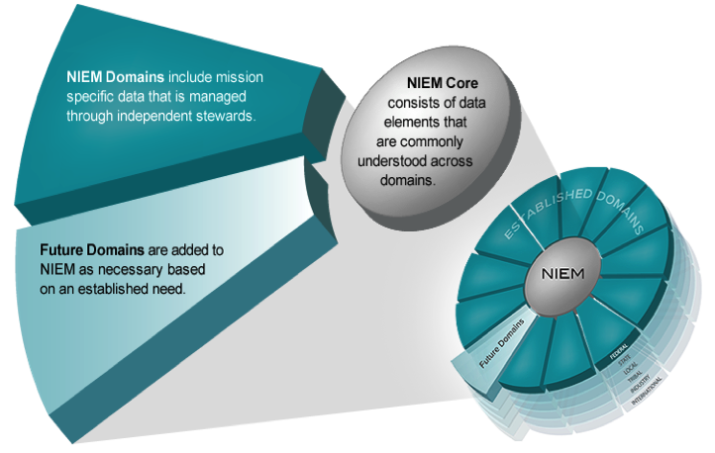
model overview
Think of the NIEM data model as a mature and stable data dictionary of agreed-upon terms, definitions, relationships and formats independent of how information is stored in individual agency systems.
The data model consists of two sets of closely related vocabularies: NIEM Core and individual NIEM Domains.
Agriculture
Biometrics
Chemical, Biological, Radiological, & Nuclear
Emergency Management
Human Services
Immigration
Infrastructure Protection
Intelligence
International Trade
Justice
Maritime
Military Operations
Screening
Surface Transportation
41
Notes:
Now, let’s take a look at the NIEM data model.
Words are to the dictionary as elements are to a data model. The NIEM data model provides common, agreed-upon terms, definitions, and formats independent of how information is stored in individual systems.
It consists of two related vocabularies, (1) NIEM core and (2) individual NIEM domains.
NIEM core consists of data elements that are commonly understood across domains. It’s governed jointly by all NIEM domains.
A NIEM domain represents both the governance and model content oriented around a community’s business needs. A NIEM domain manages their portion of the NIEM data model and works with other NIEM domains to collaboratively identify areas of overlapping interest. As a community member of NIEM, your involvement could span one or more NIEM domains. You also don’t need to be aligned to an existing NIEM domain to use NIEM, as NIEM’s core elements are universal and applicable to many or all.
Future domains are added to NIEM as necessary, based on an established business need.

Slide 42
Niem in action How NIEM ExchangeS Data Components and Data Elements
NIEM IS
a common vocabulary that enables efficient information exchange across diverse public and private organizations.
NIEM IS NOT a system or database; it does not specify how to transmit or store data.
Using NIEM, organizations come together to agree on a common vocabulary.
When additional organizations need to be added to the information exchange,
the initial NIEM exchange can be reused, saving time and money.
Notes:
Now, let’s look at NIEM in action.
It’s important to note that NIEM is NOT a system, database, software, or the actual information exchange itself. Rather, NIEM provides the common vocabulary so that organizations can speak the same language to quickly and effectively exchange meaningful data.
NIEM is the standard way of defining the contents of messages being exchanged.
Interoperability is a characteristic of information systems that use NIEM to exchange information—NIEM allows for the quick and easy addition of exchange partners, regardless of technologies being used.
For example, two organizations identify the need to exchange information. Their information, though similar, is defined differently. Both organizations have a concept of a person’s last name. One refers to it as “last name” while the other refers to it as “surname”—the same concept, but different defining term.
Using NIEM, the organizations are able to come together to agree on a common vocabulary.
When additional organizations need to be added to the information exchange, the initial NIEM exchange can be reused, saving time and money.

Slide 43
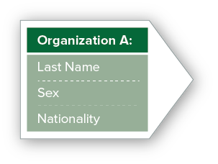
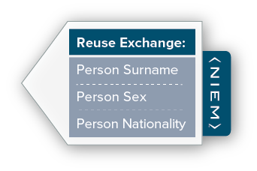
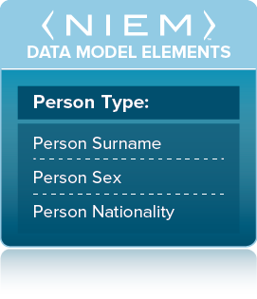
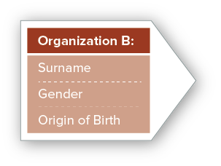
Benefit: Interoperability
NIEM provides a consistent starting point for creating information exchanges so that the sender and receiver of information share a common, unambiguous understanding of the meaning of that information.
This ensures that information is understood and carries the same consistent meaning across various communities, irrespective of technologies, allowing interoperability to occur.
Interoperability is a characteristic of information systems that use NIEM to exchange information—
NIEM allows for the quick and easy addition of exchange partners, irrespective of technologies being used.
Notes:
(Originally slide 5)
NIEM provides a consistent starting point for creating information exchanges, so the sender and receiver of information share a common, unambiguous understanding of the meaning of that information.
This ensures that information is understood and carries the same consistent meaning across various communities, irrespective of technologies, allowing interoperability to occur.
Interoperability is a characteristic of information systems that use NIEM to exchange information—NIEM allows for the quick and easy addition of exchange partners, regardless of technologies being used.

Slide 44
NIEM Community Stakeholders
Senior Leaderes
NIEM minimizes the time-to-market while allowing maximum flexibility
Program Managers
NIEM can make a job easier by helping teams build exchanges in less time, for less money time
Architects
NIEM offers a better way to exchange data and is adaptable NIEM can be modified, or new capabilities added, to an existing exchange
Developers
Tools and support are available to make exchange development easier and faster
Implementers
NIEM lowers maintenance costs when compared to legacy formats
Tool Providers
NIEM can connect with those who have an interest in information-sharing capabilities
44

