Slide 1
NIEM Health 102: An Introduction to Security and Privacy of Protected Healthcare Information
Cait Ryan
Brian Handspicker

Slide 2
NIEM Health Guidance Documents
NIEM Health 101: An Introduction to Health Information Exchange
NIEM Health 102: An Introduction to Security and Privacy of Protected Healthcare Information
NIEM Health 201: Architecting NIEM Health IEPDs using Health Information Models
NIEM Health Element Inventory
Notes:
The Federal Health Architecture (FHA), an Office of Management and Budget (OMB) e-Gov Line of business, has published a series of National Information Exchange Model (NIEM) guidance documents for the NIEM Health Community of Interest (NH-COI) and NIEM stakeholders at large.
This presentation is the second in a series - NIEM Health 102: An Introduction to Security and Privacy of Protected Healthcare Information. This document should be used in conjunction with the preceding presentation, NIEM Health 101: An Introduction to Health Information Exchange, and the follow-up presentation, NIEM Health 201: Architecting NIEM Health IEPDs using Health Information Models, and www.fhims.org.

Slide 3
NIEM Health 102
This presentation outline:
Business Security Trends
HIPAA Privacy and Security
Privacy Rule Requirements
Privacy Rule Exceptions
Security Rule Requirements
Privacy and Security Timeline
Notes:
NIEM Health102, the second of these NIEM guidance documents, provides a brief overview of the security and privacy of protected healthcare information (PHI). By the end of this guidance document you should better understand:
Protected healthcare information
Privacy requirements of HIPAA
Exceptions to the HIPAA Privacy Rule
Security consequences of the privacy requirements of HIPAA
Trusted healthcare information exchange frameworks

Slide 4
HIPAA Privacy and Security
HIPAA established regulations to protect both the privacy and security of certain health information through two key rules:
1. HIPAA Privacy Rule: national standards for the protection of certain health information
2. HIPAA Security Rule: national set of security standards for protecting certain health information that is either held or transferred in electronic form
Notes:
Privacy and security are both critical aspects of health information technology (IT). In 1996, Congress passed the Health Information Portability and Accountability Act (HIPAA), a federal law that provides data privacy and security provisions for safeguarding medical information. HIPAA resulted in established regulations to protect both the privacy and security of certain health information through two key rules:
1. HIPAA Privacy Rule: national standards for the protection of certain health information
2. HIPAA Security Rule: national set of security standards for protecting certain health information that is either held or transferred in electronic form

Slide 5
Privacy Rule Requirements
The Privacy Rule defines the concept of protected health information (PHI) which includes many common identifiers (e.g., name, address, birth date, Social Security Number) when they can be associated with the individual’s health information.
The Privacy Rule assigns individuals with specific rights to their PHI and requires all healthcare organizations and partners to protect individuals’ health records and other identifiable health information
Notes:
The Privacy Rule calls this protected health information (PHI). PHI includes demographic information, which relates to the individual’s past, present, or future physical or mental health or condition, the provision of health care to the individual, or the past, present, or future payment for the provision of health care to the individual, and that identifies the individual or for which there is a reasonable basis to believe can be used to identify the individual. Protected health information includes many common identifiers (e.g., name, address, birth date, Social Security Number) when they can be associated with the individual’s health information.
The Privacy Rule assigns individuals with specific rights to their PHI. Furthermore, the Privacy Rule requires all healthcare organizations and partners to protect individuals’ health records and other identifiable health information by establishing privacy protection safeguards as well as conditions and limits on the appropriate usage and disclosures of PHI. The Privacy Rule provides HIEs the foundation for balancing the privacy of individuals’ PHI and assuring that their PHI is accessible to healthcare parties for providing care, payment, etc. The Privacy Rule warrants that everyone’s health information is protected, especially during the ongoing flow of health information needed to provide quality health care and to protect public health.

Slide 6
Privacy Rule Exceptions
In addition, this HIPAA and HITECH legislation permits disclosure of PHI to support public health activities including:
Reporting communicable disease
Conducting public health monitoring
Public health investigations and interventions
Supporting Food and Drug Administration monitoring
Identifying patients exposed to a communicable disease
Supporting medical monitoring of the workplace
Supporting the use of certified electronic health record technology
Notes:
The Department of Health and Human Services (HHS) Office of Civil Rights (OCR) released clarifying guidance on the exceptions to the HIPAA Privacy Rule that permit disclosure of PHI. This guidance clarifies that physicians may disclose PHI to a patient’s loved ones, regardless of whether they are recognized as relatives under applicable law, and that permissive disclosures are not limited by the sex or gender identity of the person. For example, a patient’s unmarried same-sex partner is recognized as a relative with whom PHI can be shared.
In addition, this HIPAA and HITECH legislation permits disclosure of PHI to support public health activities including:
Reporting communicable disease
Conducting public health monitoring
Public health investigations and interventions
Supporting Food and Drug Administration monitoring
Identifying patients exposed to a communicable disease
Supporting medical monitoring of the workplace
Supporting the use of certified electronic health record technology
The full list of exceptions to the HIPAA Privacy Rule includes:
45 C.F.R. § 164.502(a)(1)(iii) – Incidental to a permissible use or disclosure;
45 C.F.R. § 164.506(c) – Treatment, payment, and healthcare operations purposes (e.g. quality improvement and credentialing);
45 C.F.R. § 164.510(a)(1) – Directory information (e.g. location, general health status) [requires opportunity for the patient to agree or object to the disclosure];
45 C.F.R. § 164.510(b)(1)(i) – To notify family/friends/patient-designated individuals involved in a patient’s care [requires opportunity for the patient to agree or object to the disclosure];
45 C.F.R. § 164.510(b)(1)(ii) – To notify persons responsible for a patient’s care or a patient’s location and health status [requires opportunity for the patient to agree or object to the disclosure];
45 C.F.R. § 164.512(b)(1)(i) – To legally-designated authorities for public health activities;
45 C.F.R. § 164.512(b)(1)(ii) – To report child abuse or neglect;
45 C.F.R. § 164.512(b)(1)(iii) –
45 C.F.R. § 164.512(b)(1)(iv) – To an individual exposed to or at risk of contracting a communicable disease;
45 C.F.R. § 164.512(b)(1)(v) – To an employer about an employee’s work-related illness/injury or about findings from workplace medical surveillance when the patient is treated at the employer’s request;
45 C.F.R. § 164.512(c) – To report suspected abuse, neglect or domestic violence in limited circumstances;
45 C.F.R. § 164.512(d) – To a health oversight agency for health oversight purposes;
45 C.F.R. § 164.512 (e) – In response to a judicial or administrative order, subpoena, etc.;
45 C.F.R. § 164.512(f) – To law enforcement for limited purposes (e.g. reporting a crime on site);
45 C.F.R. § 164.512 (g)(h) – To coroners, medical examiners, funeral directors, and organ procurement agencies to enable their legally authorized duties;
45 C.F.R. § 164.512(i) – For research purposes subject to restrictions
45 C.F.R. § 164.512(j) – To a person reasonably able to prevent a serious and imminent threat to the health or safety of a person or the public
45 C.F.R. § 164.512(k) – For specialized government functions (e.g. national security);
45 C.F.R. § 164.512(l) – To an organization responsible for providing worker’s compensation benefits.
Please reference “The Nationwide Privacy and Security Framework for Electronic Exchange of Individually Identifiable Health Information (the Privacy and Security Framework)”, the “HIPAA Omnibus Rule”, and the “Health Information Technology for Economic and Clinical Health Act (HITECH)” for additional information regarding exceptions and exclusions for PHI and HIEs.
I’m torn wrt specifically documenting the Justice assertion that “they are not covered entities” and therefore the privacy rule doesn’t apply to them. I think other specifically documented exceptions are a better foundation for the Justice NH Use Cases. I can’t imagine a case where actual healthcare information was to be exchanged that hadn’t, at one point, been provided by a covered entity. So claiming to not be a CE is a specious argument.
Should we add links to these?

Slide 7
Security Rule Requirements
The Security Rule enables the Privacy Rule’s protections by establishing both technical and non-technical guidance and requirements which “covered entities” must both comply with and operationalize to secure e-PHI.
In 2009, The Health Information Technology for Economic and Clinical Health (HITECH) Act was authorized to promote the adoption and meaningful use of HIT and ensure the privacy and security of the electronic transmission of PHI.
Notes:
The Security Rule enables the Privacy Rule’s protections by establishing both technical and non-technical guidance and requirements which “covered entities” must both comply with and operationalize to secure e-PHI. The Security Rule’s flexibility and scalability empowers the diverse healthcare market to operationalize policies, procedures, and technologies relative to the entity’s organizational size, structure, and security and privacy risks to their consumers’ e-PHI.
In 2009, The Health Information Technology for Economic and Clinical Health (HITECH) Act was authorized through the American Recovery and Reinvestment Act (ARRA) to promote the adoption and meaningful use of HIT. Specifically, Subtitle D addresses the privacy and security of the electronic transmission of PHI or electronic PHI (ePHI), including strengthening legal enforcement of HIPAA. The following timeline illustrates the various security and privacy legislation and accompanying guidance that exist for the protections of PHI.

Slide 8
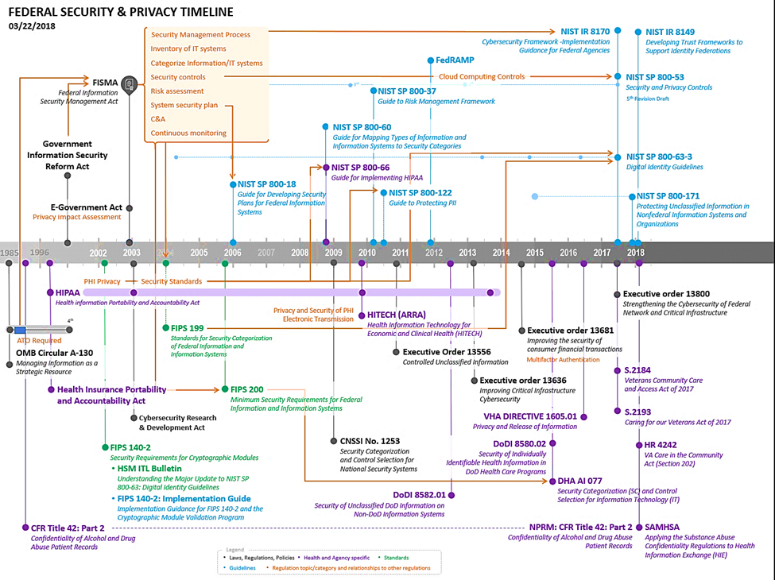
Privacy and Security Timeline
Notes:
The scope of this presentation is to provide a high-level overview of HIPAA requirements for protecting certain health information. It is important to point out the many laws that govern and direct privacy and security of protected health information. Below is a timeline FHA created that depicts the evolution of privacy and security governance for the federal agencies. A table with links to helpful references for additional reading is included. It is important to note that state and local governments often have their own laws for security and privacy.
Please reference The Nationwide Privacy and Security Framework for Electronic Exchange of Individually Identifiable Health Information (the Privacy and Security Framework), the HIPAA Omnibus Rule, and the Health Information Technology for Economic and Clinical Health Act (HITECH) for additional information regarding PHI and HIEs.

Slide 9
Conclusion
NIEM is currently supporting the secure and private exchange of information in production today. As NIEM's adoption continues to grow, non-clinical domains that utilize health data elements for information exchange will require clinical informatics subject matter expertise to securely and privately navigate through the complexities of the HIT/HIE environment.
Notes:
NIEM is currently supporting the secure and private exchange of information in production today. As NIEM's adoption continues to grow, non-clinical domains that utilize health data elements for information exchange will require clinical informatics subject matter expertise to securely and privately navigate through the complexities of the HIT/HIE environment.

Slide 10
Thank You

