Slide 1
NIEM Health Scenarios Single to Multiple Domain Edge-Case Interoperability
August 29, 2019

Slide 2
Table of Contents
Introduction | 3
NIEM Health Terminology | 6
NIEM Health Edge Case Scenario List | 7
Hurricane, Flooding, Famine, Epidemic | 8
Earthquake Tsunami Causes Nuclear Meltdown | 9
Drought Wildfires | 10
Dirty Bomb on High Seas | 11
Multi-Vehicle Accident | 12
Building Collapse | 13
Ebola-Infected Flight | 14
Foster/Juvenile Medical Records | 15
Wounded Warrior on Battlefield | 16
Reentry into the Community after Incarceration | 17
Tracking Opioid Abuse and Illegal Distribution Networks | 18
Vaccine Causing Widespread Allergic Reactions | 19
Pharmaceutical Recall | 20

Slide 3
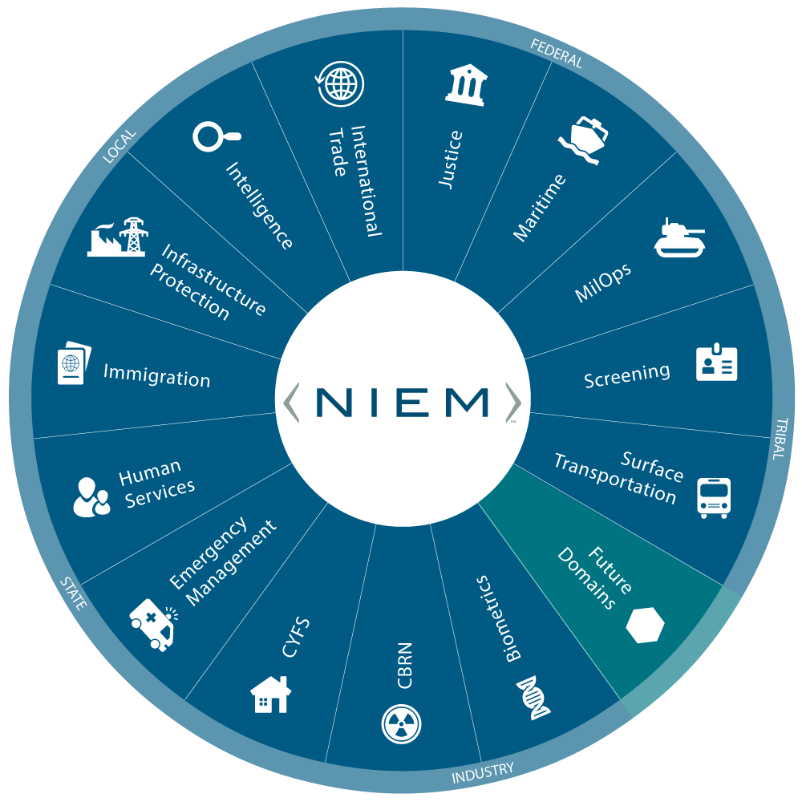
NIEM Community
DOMAINS
Agriculture
Biometrics
CBRN
Emergency Management
Human Services
Immigration
Infrastructure Protection
Intelligence
International Trade
Justice
Maritime
MilOps
Screening
Surface Transportation
Future
Cyber
Statistics
Humanitarian Aid
COMMUNITY OF INTEREST
Health
Notes:
NIEM has model content for 14 domains, which are community-specific business areas plus Common Core Domain.

Slide 4
NIEM Health Crosses MULTIPLE Domains
Inmate
Release
Clinical Health
Justice
Human Services
MilOps
Emergency Mgt
Custody
Determination
Natural
Disaster
Terrorist
Attack
Foster Children
Medical
Records
Wounded
Warrior
Notes:
When NIEM Domains need to collect or exchange healthcare information, generally that information is not centric to the business of the domain, but is collected from the healthcare world at the "edge" of the domain. And similarly from the healthcare IT world's perspective, information that needs to transit from the HIT standards-based clinical world out to a NIEM Domain, is transiting at the edge of the clinical world. So, from the perspective of both NIEM Domains and the Clinical Healthcare Domain NIEM Health Information Exchange is an edge-case that is not centric to their realm.
So far over 400 health-related and mental health-related NIEM Elements have been publicly defined across 6 of the 14 NIEM Domains, with no indication that these definitions have been coordinated with each other nor aligned with Health IT standards.
So it is clear that NIEM Domains have a need to collect or exchange healthcare information which is not centric to their business but is collected at the "edge" of the domain.
Similarly, information that needs to transit from the Clinical Health Domain to a NIEM Domain is transiting at the “edge” of the clinical health domain to the non-clinical domain (e.g. Emergency Management, Child and Family Services, etc.)
Therefore, NIEM Health Information Exchanges are “edge-cases” not centric to their realms

Slide 5
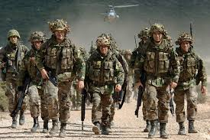
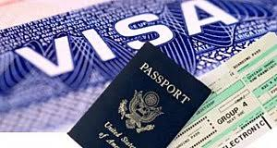
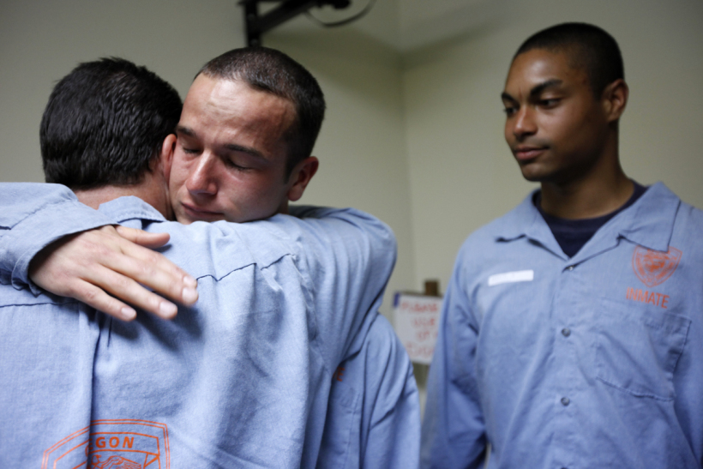
Emergency Management
Military Operations
Maritime
Biometrics
Justice
Immigration
International Trade
Agriculture
Human Services

Slide 6
NIEM Health Terminology
Scenario: A broadly defined situation which merits a response in favor of the public good.
Use-Case: One or more steps taken to, hopefully successfully, resolve a scenario. A use-case is often triggered by a specific event which results in a specific actor to pursue a specific action in hopes of achieving a desired result.
Use-Case Event: a situation, milestone, metric, etc. which occurs during a scenario to trigger a use-case designed to resolve some or all of the issues associated with the scenario.
Use-Case Actor: an individual, or group of individuals, or an organization tasked with performing the use-case action in hopes of achieving a positive use-case result.
Use-Case Action: the step or set of steps that an actor must perform in hopes of achieving a positive use-case result.
Use-Case Result: the consequence of an actor performing an action in response to an event as part of resolution of a scenario.
Requirement: a singular documented physical or functional need that a particular design, product or process aims to satisfy. A requirement may be associated with a specific scenario, or a use-case, or an entire system designed to meet a broader set of needs than just one scenario or use-case.

Slide 7
NIEM HEALTH SCENARIOS
NATIONAL DISASTER RESPONSE
Hurricane/Flood
Earthquake/Tsunami
Drought/Wildfire
Dirty Bomb on the High Seas
LOCAL EMERGENCY RESPONSE
Multi-Vehicle Accident with Trauma and Burns
Building Collapse Requiring Search and Rescue
Ebola-Infected Flight Arriving
MEDICAL RECORD EXCHANGE
Foster/Juvenile Medical Records
Wounded Warrior on Battlefield
Reentry into the Community after Incarceration
SUBSTANCE ABUSE MONITORING
Substance Abuse Rehab with Effective Supervision
Tracking Opioid Abuse and Illegal Distribution Networks
Law Enforcement Poisoned by Drugs During Mission

Slide 8
NIEM Health Scenarios
Hurricane, Flooding, Famine, Epidemic Destruction, Death, Homelessness, Famine, Epidemic, Energy Crisis
Description: A category five storm with winds topping 175mph makes landfall along the U.S. gulf coast with a 28 foot storm surge. Protective estuaries and wetlands are overwhelmed allowing the wind-driven water surge to reach inland cities and towns. Buildings in the path of the storm and surge are destroyed with significant loss of life and creating millions of now homeless residents. The storm path takes it up the Mississippi River breaching levees and flooding farmland. The destruction of warehoused food and destruction of crops leads to widespread famine amongst storm refugees. In addition, overflooding of sewage systems leads to widespread bacterial illnesses. Finally, destruction of regional refineries leads to national energy shortfalls. | Specific Challenges: housing destruction, infrastructure destruction, agricultural destruction, food shortfalls, epidemic illnesses, energy shortfalls, destruction of protective wetlands
 | Domains: Emergency Mgmt, Infrastructure Protection, Agriculture, Human Services, Health, Surface Transportation
 | Agencies: FEMA, Agriculture, Coast Guard, DoE, EPA, DHS, CDC, ACF

Slide 9
NIEM Health Scenarios
Earthquake Tsunami Causes Nuclear Meltdown Destruction, Death, Homelessness, Fallout, Radiation Sickness, Nuclear Crisis
Description: An earthquake with magnitude 7.4 occurs off the coast of California triggering a tsunami with 100 foot tidal surge. The earthquake causes ruptured pipes in a nuclear power plant which subsequently is flooded by the tsunami surge. In addition to the impending nuclear disaster the tsunami floods coastal cities and towns. Buildings in the path of the surge are destroyed with significant loss of life and creating millions of now homeless residents. In addition, overflooding of sewage systems leads to widespread bacterial illnesses. Finally, destruction of regional coastal refineries leads to national energy shortfalls. | Specific Challenges: housing destruction, infrastructure destruction, nuclear disaster
 | Domains: Emergency Mgmt, Infrastructure Protection, Human Services, Health, Surface Transportation
 | Agencies: FEMA, Coast Guard, DoE, EPA, DHS, CDC, ACF

Slide 10
NIEM Health Scenarios
Drought Wildfires Destruction, Death, Homelessness, Pollution, Famine
Description: A long-running drought devastates crops and sets the stage for widespread wildfires. The large number of natural and human triggered wildfires overwhelms the ability of firefighters to respond. Fires destroy multiple towns with some loss of life and millions of residents made homeless. In addition the fires take a significant toll on firefighters and other first responders, as well as citizens living downwind of the fires. | Specific Challenges: housing destruction, infrastructure destruction, refugees, localized and potentially nationwide food shortages, pollution, environmental disaster
 | Domains: Emergency Management, Infrastructure Protection, Human Services, Health
 | Agencies: FEMA, EPA, DHS, ACF

Slide 11
NIEM Health Scenarios
Dirty Bomb on High Seas Terrorism or a virus? Is cargo tainted? Is a bomb onboard?
Description: A Singapore-flagged break-bulk cargo ship carrying sacks of rice and other foods bound for Port of Seattle from SE Asia radios that it is declaring an emergency just outside of the Strait of Juan de Fuca (entrance to Ports of Vancouver & Seattle). The entire crew has become incapacitated due to norovirus-like symptoms (nausea, vomiting, diarrhea, weakness). Shortly after initial contact the ship radios that they have found a dozen stowaways on board (men, women, children) with same symptoms plus their hair is falling out. The Captain is now concerned that crew and stowaways are suffering radiation sickness from a smuggled dirty bomb. Captain requests aid. | Specific Challenges: terrorism, CBRN device, food adulteration, human smuggling, health, threat to port and major metropolitan area, multi-national response (US&Canada)
 | Domains: Every domain except Surface Transportation
 | Agencies: FEMA, CWMD, Coast Guard, DoE, EPA, DNI et al., DHS, ICE, FBI, FDA, CDC, ACF, State, DoD, Canadian agencies

Slide 12
NIEM Health Scenarios
Multi-Vehicle Accident Trauma and Burns, Spill Toxic Cargo, Children of Victims
Description: Dense fog on an Interstate highway triggers a chain-reaction crash of dozens of cars and trucks. First responders find so many injured drivers and passengers that no one hospital can handle all the victims. In addition major trauma and burns will require specialists that not all hospitals offer. First responders need to triage the victims and determine which hospitals in the region and in neighboring states can accept and treat the victims. This requires the ability to inquire of multiple facilities about the availability of beds, specialists, and equipment. In addition, once victims are dispatched to the various hospitals they must track where they have been sent and deal with any unharmed minors. | Specific Challenges: Beds, Specialists, and Equipment Availability; Patient Tracking
 | Domains: Emergency Mgmt, Infrastructure Protection, Human Services, Health
 | Agencies: EPA, DHS, ACF, Health

Slide 13
NIEM Health Scenarios
Building Collapse Requiring Search and Rescue
Description: A major city building collapses killing or injuring thousands of residents and visitors. Terrorism is suspected but not certain. Fires have broken out due to broken gas mains, oil tanks, and other unknown flammable substances. Survivors are trapped in burning rubble. | Specific Challenges: Search and rescue; hazardous substances; beds, specialists, and equipment availability; patient tracking, availability of search and rescue dogs and handler.
 | Domains: Emergency Mgmt, Infrastructure Protection, Intelligence, Human Services, Health
 | Agencies: Justice, FBI, Local First Responders, EPA, DHS, HHS, ACF, Health

Slide 14
NIEM Health Scenarios
Ebola-Infected Flight Flight Control Coordinates with First Responders and Health Resources
Description: The captain of an incoming international long-haul flight declares a public health emergency due to a number of passengers who are exhibiting symptoms of a hemorrhagic fever disease (fever, sore throat, muscular pain, and headaches, followed by vomiting, diarrhea and rash, sometimes followed by bleeding both internally and externally.) The flight is diverted to Boston, the closest major metropolitan area on the flightpath with the healthcare resources to diagnose, quarantine, and care for the passengers of the flight. The plane itself must also be quarantined and decontaminated by a specialist maintenance crew. | Specific Challenges: Beds, Specialists, and Equipment Availability; Patient Tracking
 | Domains: Emergency Mgmt, Infrastructure Protection, Human Services, Health, Immigration, Screening, FAA
 | Agencies: EPA, DHS, CDC, HHS, ACF, Health, State
WHO defines a public health emergency of international concern as "an extraordinary event" that constitutes a "public health risk to other States through the international spread of disease" and "to potentially require a coordinated international response."

Slide 15
NIEM Health Scenarios
Foster/Juvenile Medical Records Regulatory Requirement to Collect and Maintain All Records for Children in State Care
Description: Federal and State laws, rules and regulations require the collection, storage and maintenance of all official records associated with a child in the care of the state, e.g. foster children, juvenile justice prisoners, disabled children in state care, etc. These records include, but are not limited to, medical records, pharmaceutical records, therapy records, educational records, criminal records, family law records, financial records, and case management records. These records are required to be store independent of their source systems. They are to be turned over the child at age 18 (or 21 is a foster child whose post-secondary education is paid for by the U.S. Government). | Specific Challenges: collection of records from systems with different data models, schemas, and information exchange architectures
 | Domains: Human Services, Family Services, Justice, Health, [Education]
 | Agencies: State ACF, State Health, State Education, State Justice

Slide 16
NIEM Health Scenarios
Wounded Warrior on Battlefield Access to Medical Records between NATO Allies via Common C3 Systems
Description: International military allies, e.g. NATO, have widely differing policies with regard to medical information sharing and widely differing systems supporting medical information exchange. Yet during a joint military engagement, allies fighting side-by-side may get wounded and require the availability of the warrior’s medical information for treatment by an ally. Until we have achieved implementation of global standards-based healthcare information exchange and common associated health information sharing policies, we need some mechanism for exchanging medical information during such a crisis. Since the allies have settled on NIEM for Command and Control information exchange, perhaps we can enable the exchange of wounded warrior medical information via NIEM Health. | Specific Challenges: Mapping of healthcare information models between clinical standards (e.g. HL7, FHIR, etc.) and NIEM Health, Creation of a NIEM-to-HL7/FHIR bridge for exchange of medical information between disparate systems.
 | Domains: MilOps, Health
 | Agencies: DoD

Slide 17
NIEM Health Scenarios
Reentry into the Community after Incarceration
Description: Reentry is a public health issue. Individuals released from prisons and jails represent a substantial share of the U.S. population carrying communicable diseases, accounting for nearly a quarter of the general population living with HIV or AIDS, almost a third of those with hepatitis C, and nearly 40 percent of people with tuberculosis. Appropriate interventions – especially upon return to the community – present a significant public health opportunity. | Specific Challenges: medical record exchange, prescription record exchange, therapy record exchange between NIEM-based prison/jail systems and HL7-based clinical systems
 | Domains: Justice, Human Services, Public Health, Family Services
 | Agencies: Justice, HHS, CDC, ACF

Slide 18
NIEM Health Scenarios
Tracking Opioid Abuse and Illegal Distribution Networks
Description: The opioid crisis is a public health emergency that threatens the wellbeing of individuals who abuse drugs and impacts the safety of communities. It impacts first responders, the criminal justice system, child welfare and foster care, and behavioral health systems. By tracking legal distribution of opioids and other prescription medications as well as the precursor chemicals required for illicit manufacturing of dangerous substances, we can identify patterns that might lead to the identification and arrest of the actors in illegal drug distribution networks. | Specific Challenges: enabling and encouraging reporting of legal drug and chemical distribution, enabling reporting of drug overdose reports as an indicator of prevalence of abuse, correlating distribution patterns and abuse patterns to identify illicit distribution networks
 | Domains: Justice, Health, Human Services
 | Agencies: Justice, HHS

Slide 19
NIEM Health Scenarios
Vaccine Causing Widespread Allergic Reactions
Description: The Vaccine Adverse Event Reporting System (VAERS) is a program supported by the Centers for Disease Control and Prevention (CDC) and the Food and Drug Administration (FDA). The current system is implemented with webforms for reporting and emailed/webpage distribution of results. | Specific Challenges: Retooling an existing successful system; VAERS
 | Domains: Health
 | Agencies: CDC, FDA

Slide 20
NIEM Health Scenarios
Pharmaceutical Recall
Description: The Pharmeceutical Recall system is a program supported by the Centers for Disease Control and Prevention (CDC) and the Food and Drug Administration (FDA). The current system is implemented with webforms for reporting and emailed/webpage distribution of results. | Specific Challenges: Retooling an existing successful system
 | Domains: Health
 | Agencies: CDC, FDA

